Slide 1
FACE MASK DETECTION
Using YOLO

Slide 2

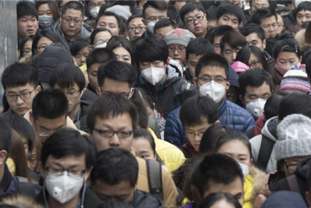
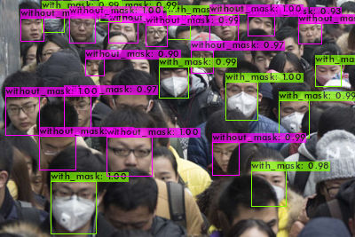
WORKFLOW
MANAGEMENT
Live feed from security cam
Video Frame
Mask Detection using YOLO v4
ADMIN
(report to admin)
The frames having people not wearing mask are being captured

Slide 3
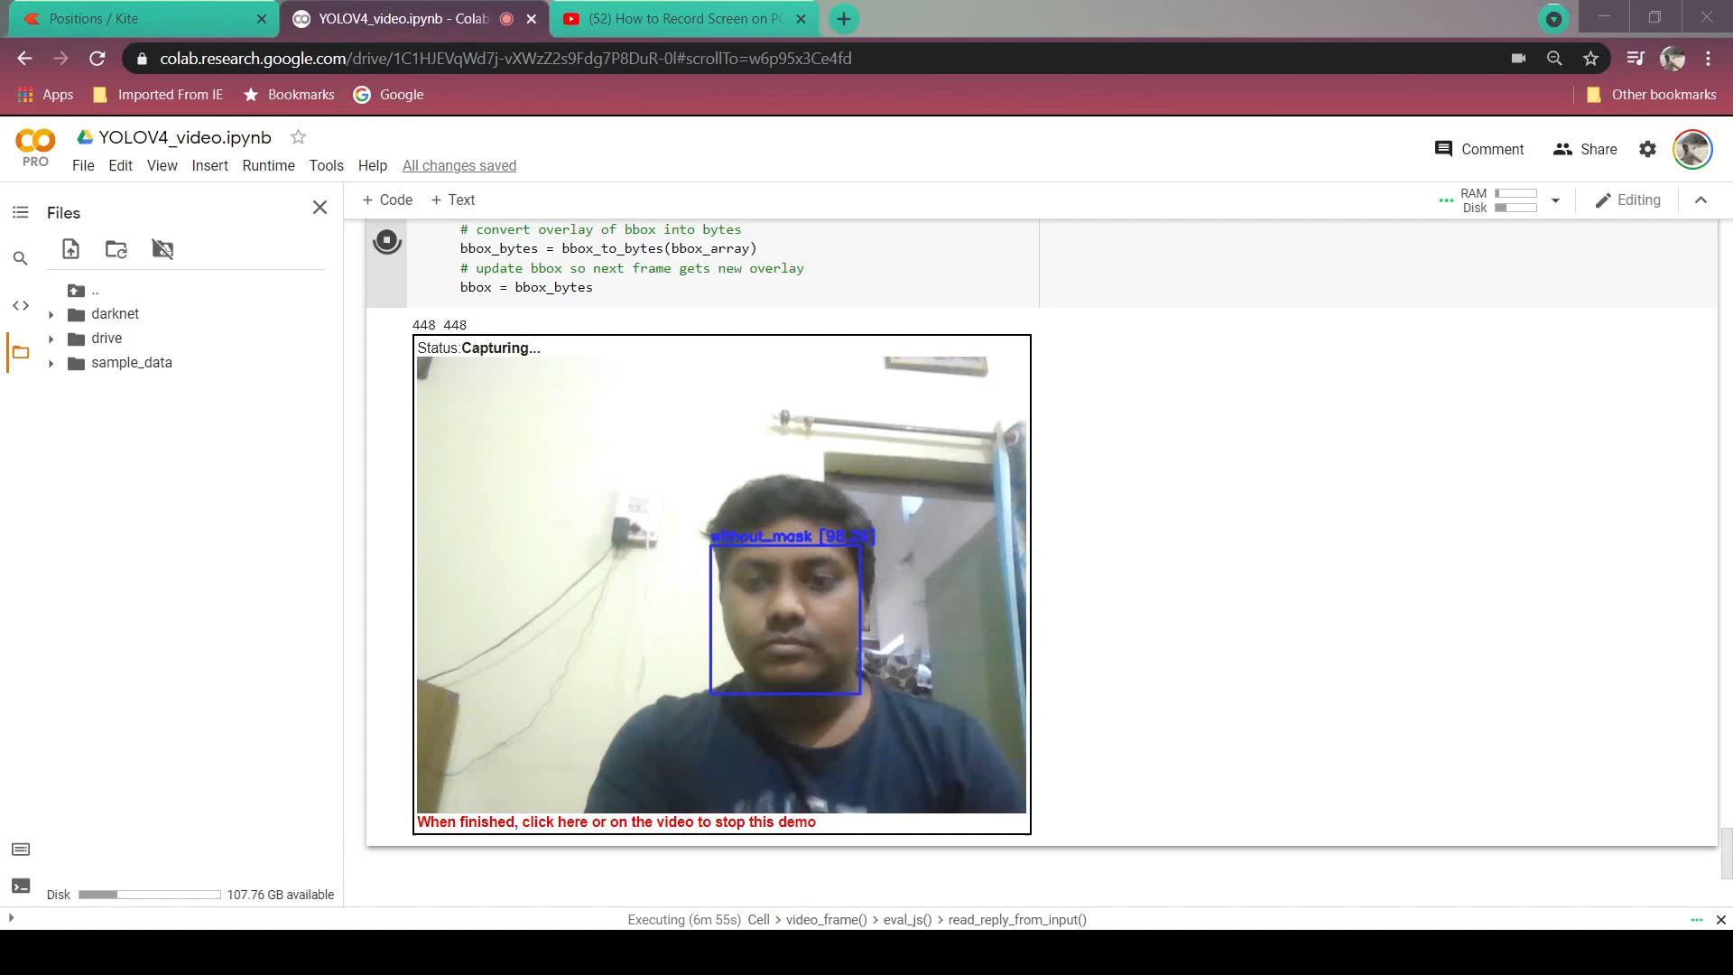
VIDEO DEMO

